Slide 1

By:
Nahid Mozhdehi

Slide 2
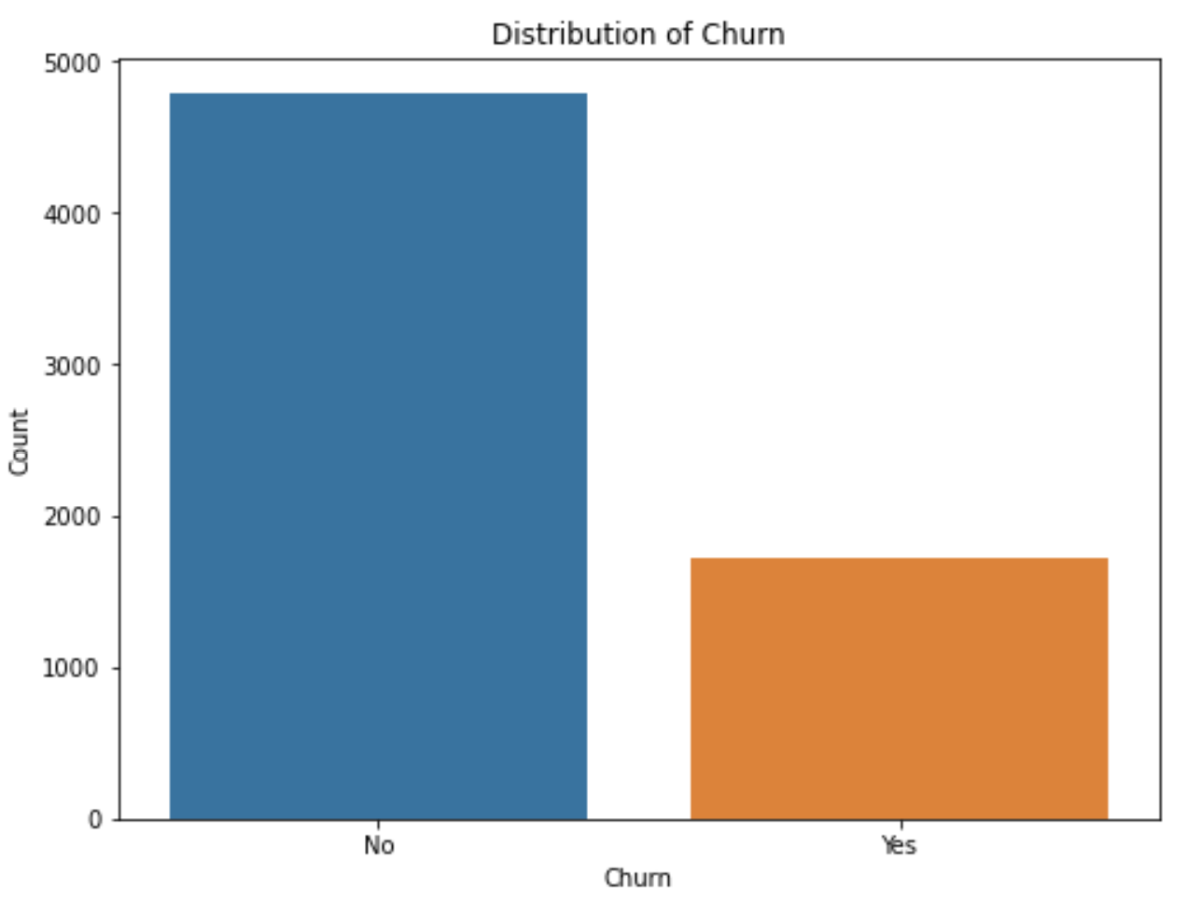
Problem identification
Customer churn is a critical metric
Company revenue
Company growth
Project Goal
improve customer retention
reduce churn rates

Slide 3
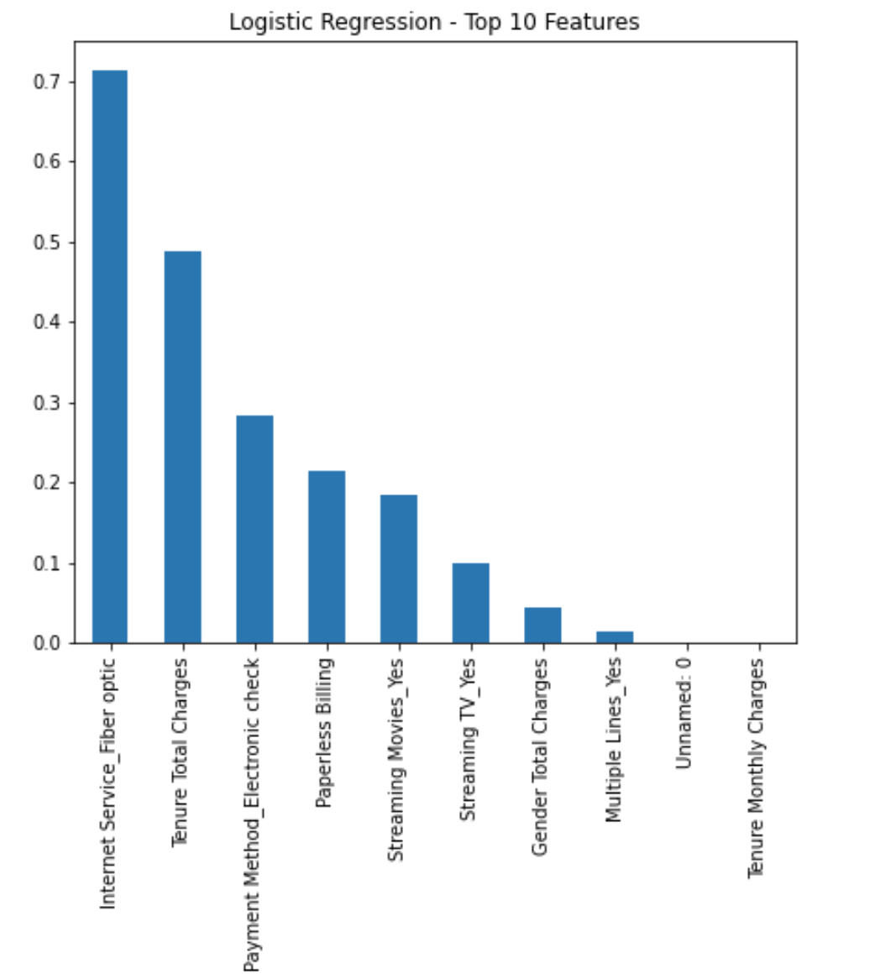
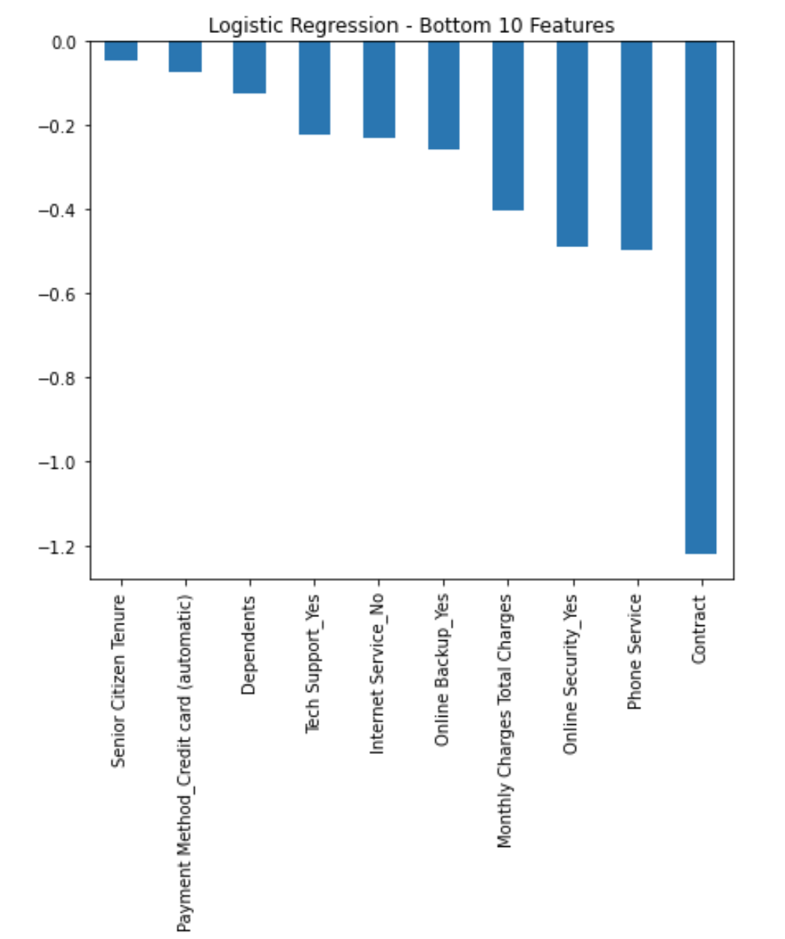
Key Findings

Slide 4
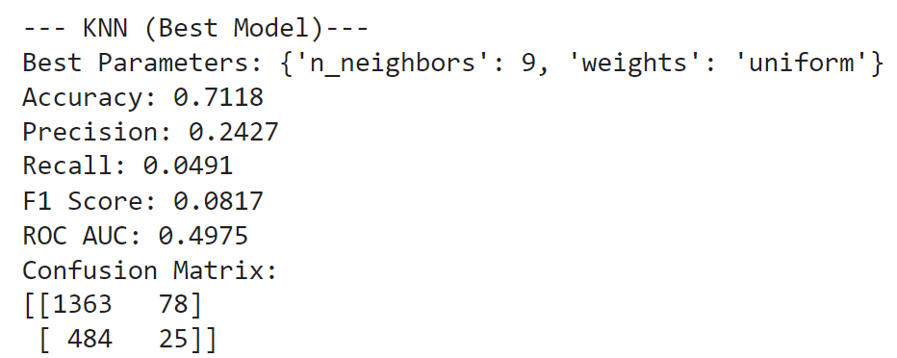
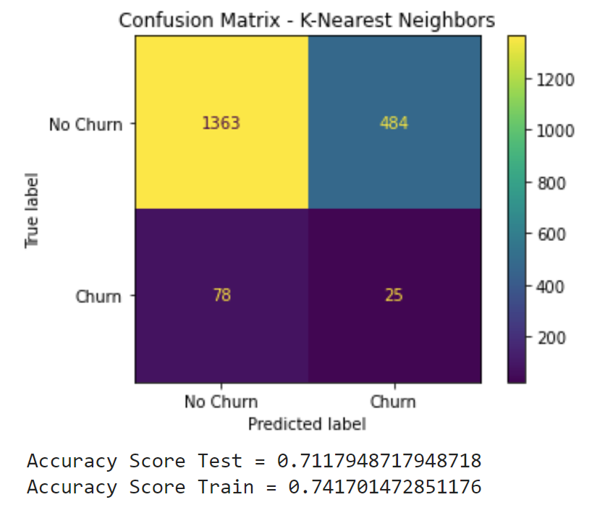
Modeling results - KNN

Slide 5
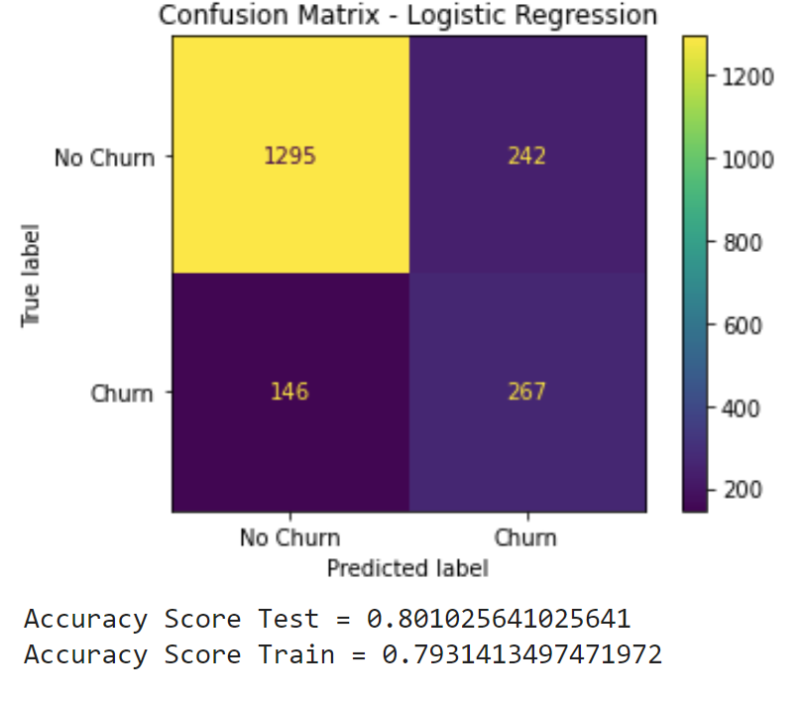
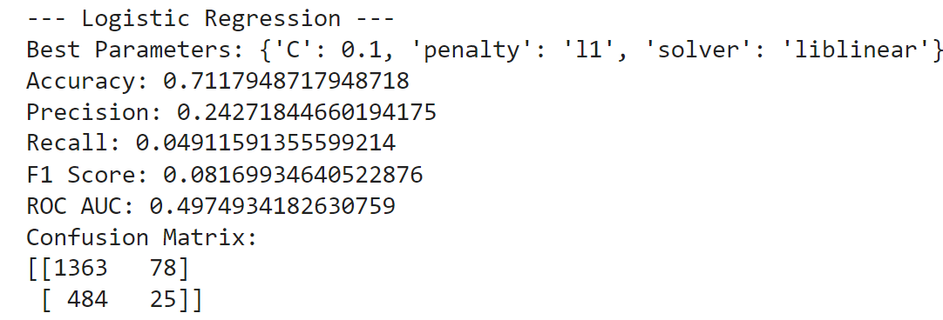
Modeling results - Logistic Regression

Slide 6
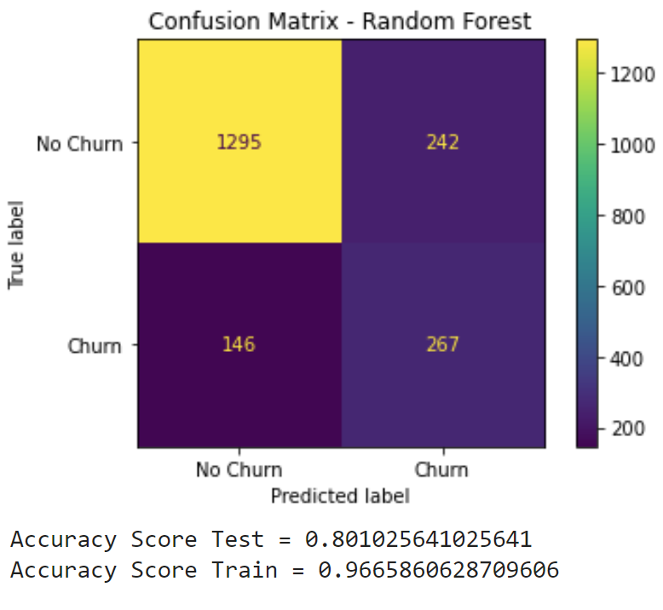
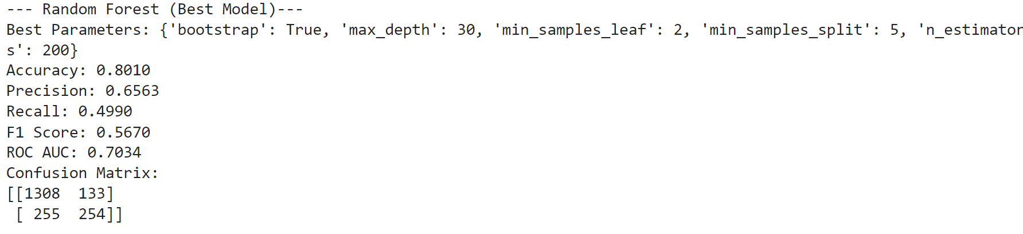
Modeling results - Random Forest

Slide 7
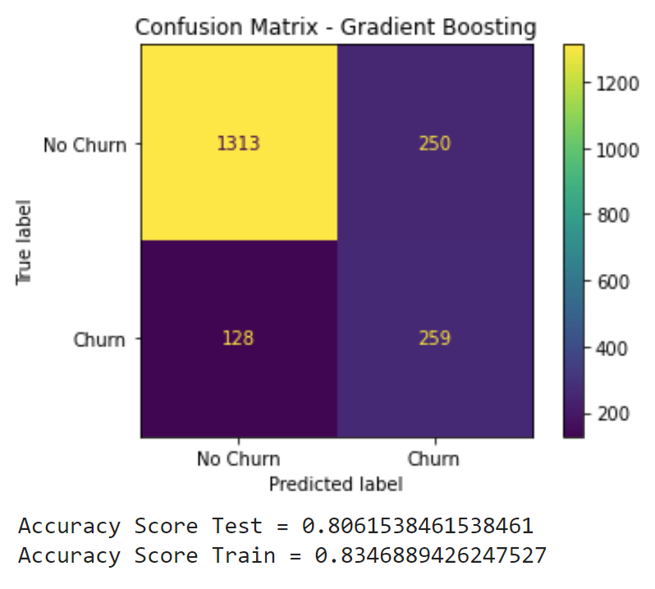
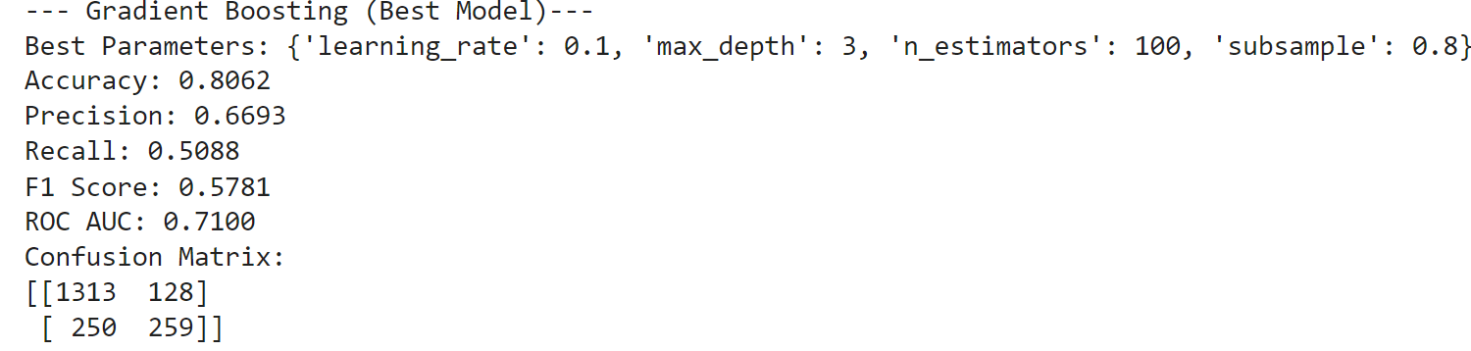
Modeling results - Gradient Boosting

Slide 8
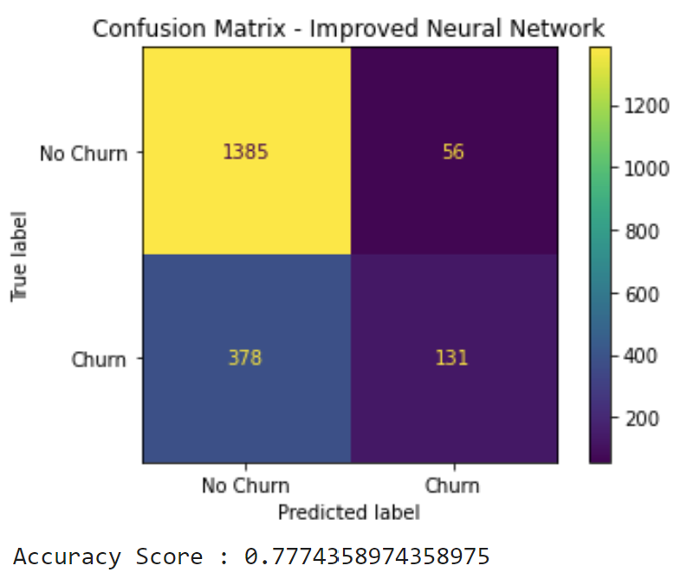
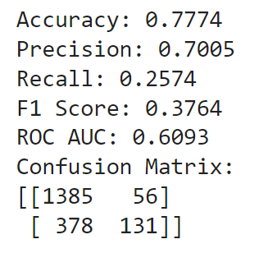
Modeling results - Hyperparameter Tuning Neural Network

Slide 9
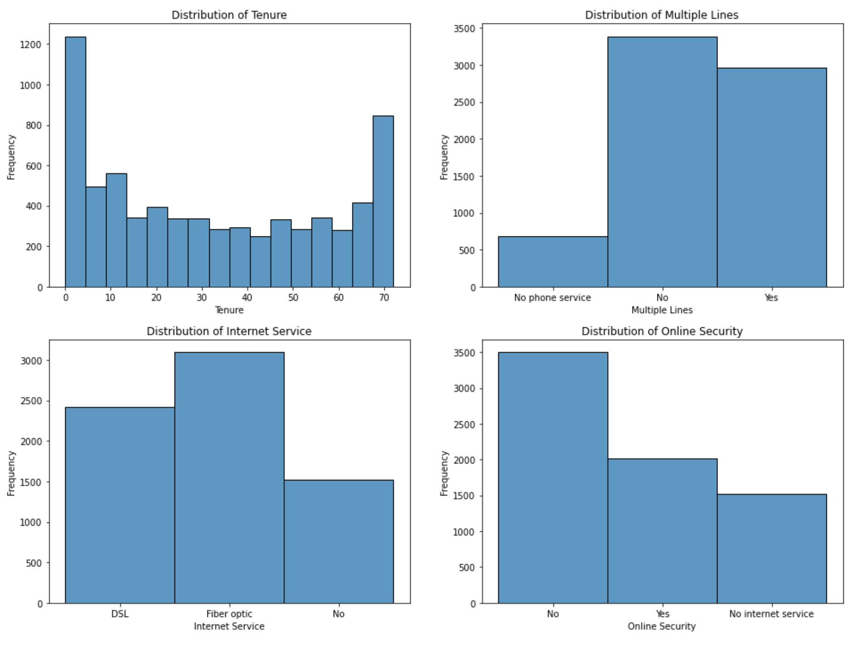
Analysis

Slide 10
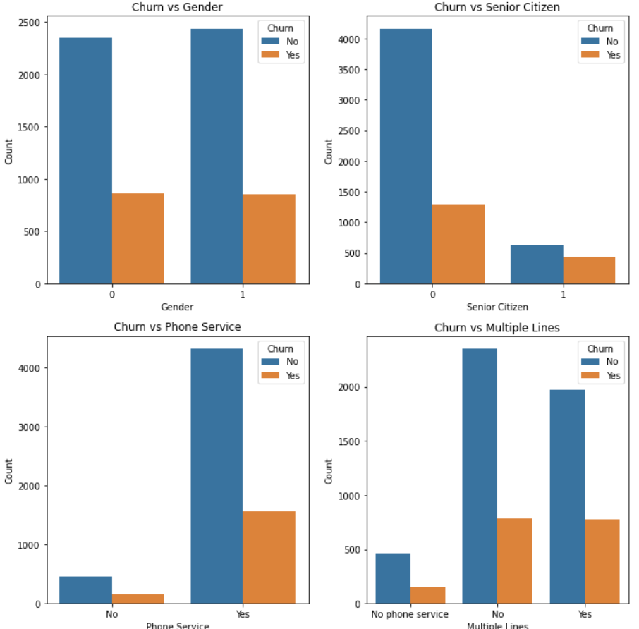
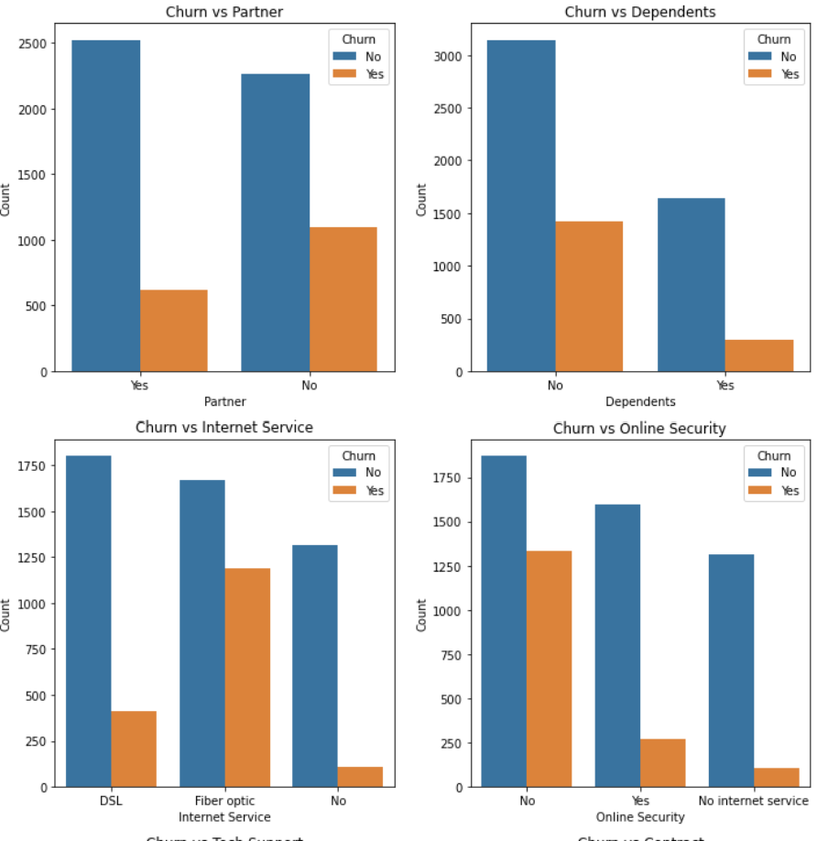
Analysis

Slide 11
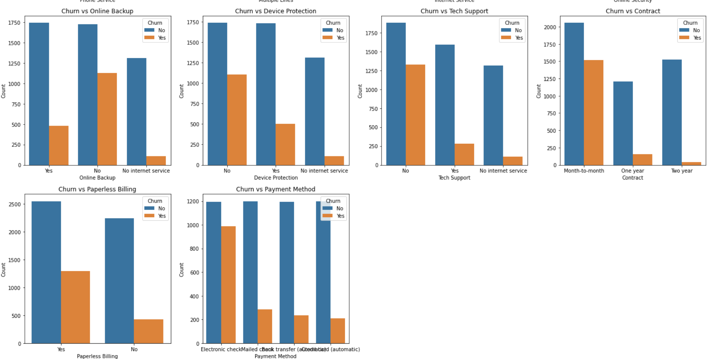
Analysis

Slide 12
Conclusion
Enhance model performance
Strategies such as further
hyperparameter tuning
advanced feature engineering
addressing class imbalances

